Slide 1
MRI Brain Tumor Detection using Convolutional Deep Learning Methods
Nassim Ali-Chaouche, Kartik Mukkavilli,
Quan Gu, Nail Enikeev
Department of Applied Data Science, San Jose State University
DATA 255: Deep Learning Technologies
Simon Shim, PhD

Slide 2
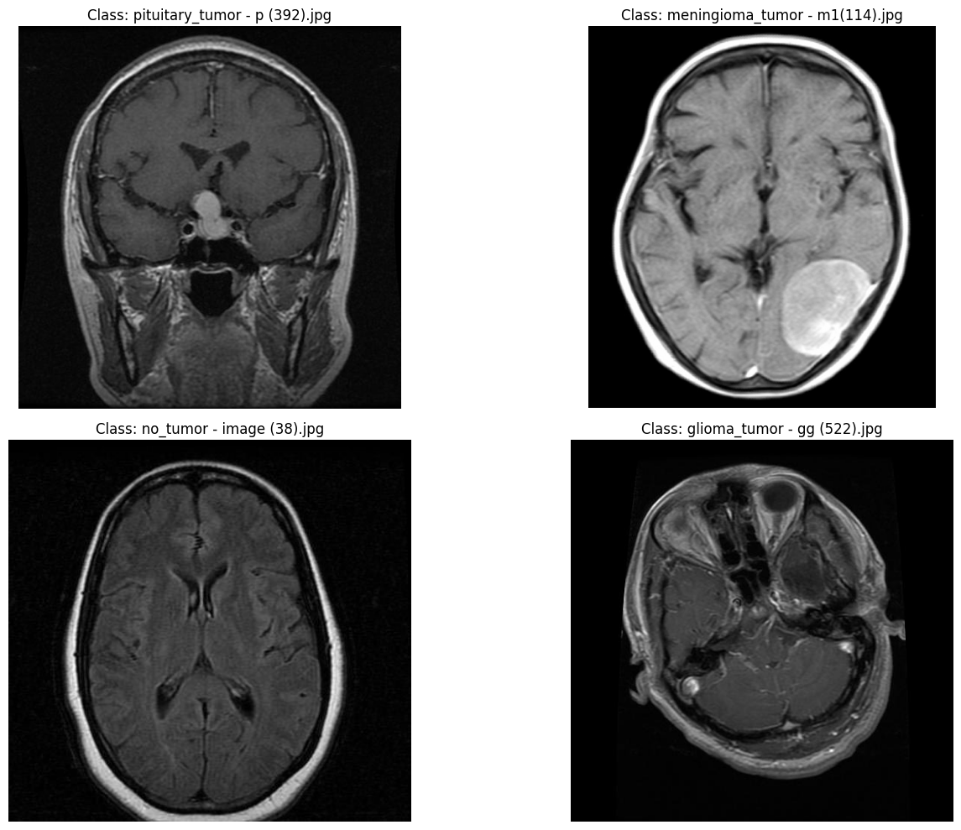
Brain Tumor Classification(MRI)
The best technique to detect Brain Tumor: MRI (Magnetic Resonance Imaging)
Brain Tumors are classified as:
Glioma Tumor, Malignant Tumor, Pituitary Tumor, No Tumor
Difficulties: Highly depends on the experience level of Radiologists or Doctors
3D Structure
Multiple Tumor Types
Multiple potential locations
Convolutional Neural Network (CNN), Artificial Neural Network (ANN), Transfer Learning (TL)

Slide 3
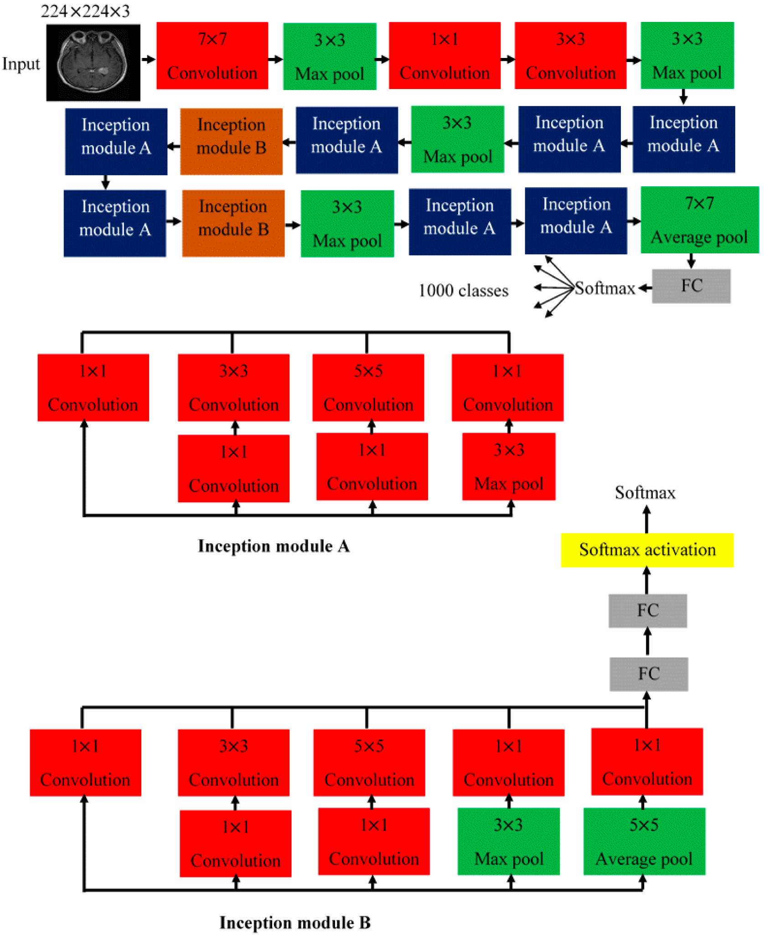
Categories of Techniques
Convolutional Neural Network (CNN):
Complex Patterns
Hybrid Models
DenseNet121-UNET
Deep Learning Architectures
ResNet50
VGG19
Innovative approaches
Inception V3
Vision Transformers
Refined CNN with Inception: AlTahhan, F. E., Khouqeer, G. A., Saadi, S., Elgarayhi, A., & Sallah, M.

Slide 4
Literature Review
Refined Approach to CNN:
AlTahhan, F. E., Khouqeer, G. A., Saadi, S., Elgarayhi, A., & Sallah, M.
GoogleNet, AlexNet: Dynamic evolution of CNNs, ability to integrate and adapt with technologies to improve analysis of MRI scans
Densenet121-UNET:
Cinar, N., Ozcan, A., & Kaya, M. (2022)
Densenet121: Feature Propagation and Reuse, efficient for image classification
UNET: Medical Image Segmentation
Resnet-50:
Rathore, S., Rana, T., Mittal, U., Gupta, T., Malik, N., & A S, M. S. (2023)
Residual Learning (skip connections) for deeper Neural Network training
VGG-19
Siddaiah, N., Vignesh, C., Narendra, T., Pujitha, K., &amp; Madhu, D. (2022)
Simplicity, 19 Layers, 3x3 Convolutional filters
Detail Feature Extraction

Slide 5
Literature Review
Inception V3:
Cahall, D. E., Rasool, G., Bouaynaya, N. C., & Fathallah-Shaykh, H. M. (2019)
Advanced CNN, ability to discern intricate patterns and variations in brain scans
Vision Transformers:
Asiri, A. A., Shaf, A., Ali, T., Pasha, M. A., Aamir, M., Irfan, M., Alqahtani, S., Alghamdi, A. J., Alghamdi, A. H., Alshamrani, A. F., Alelyani, M., & Alamri, S. (2023).
Focuses on advancing brain tumor classification using fine-tuned vision transformers
Those transformers have potential to surpass traditional CNNs in certain cases
Hybrid and Advanced Models:
Cinar, Ozcan, and Kaya (2022)
Introduces a hybrid DenseNet121-UNET model for segmenting brain tumors
Integrates DenseNet architecture with UNET framework resulting in higher accuracy for MRI scans
Anand, V., Gupta, S., Gupta, D., Gulzar, Y., Xin, Q., Juneja, S., Shah, A., & Shaikh, A. (2023)
Proposed a weighted average ensemble deep learning model
Makes ensemble methods for diagnostic precision for prominent

Slide 6
Literature Review
Convolutional Neural Networks (CNNs):
Saeedi, S., Rezayi, S., Keshavarz, H., &amp; R. Niakan Kalhori, S. (2023)
Deploys convolutional deep learning methods with certain machine learning methods to give more emphasis on CNNs for detecting brain tumors
Vankdothu, Hameed, and Fatima (2022)
Integrates CNN with Long Short-Term Memory networks
Emphasizing how these technologies work together to increase classification precision

Slide 7
Data Exploration and Processing

Slide 8
Data Source
Image data for this project comes from the “Brain Tumor Classification (MRI)” dataset on Kaggle.
Two folders: “Testing” and “Training”
Within each folder, there are four folders which contain images for the classes:
“glioma_tumor”, “meningioma_tumor”, “no_tumor”, and “pituitary_tumor”
Task for this project involves multiclass image classification comprising four distinct classes.

Slide 9
Data Cleaning
Purpose: Verify the integrity of the data and to ensure there will not be any issues during the modeling phase.
Images were checked using the PIL library’s ‘verify’ function, and by using the OpenCV library
All of the images were valid (not corrupt)
Images that were less than 32x32 or greater than 2048x2048 were removed
Might cause issues during modeling otherwise; no images were removed
All files that were not images were removed

Slide 10
Validation Set
10% of the images from the original train set (from the “Training” folder) are set aside to be used as a validation set, remaining 90% used as a new train set
Both sets maintain the same class distribution as the original “Training” folder
Purpose of the validation set: monitor overfitting in the later modeling phase
The “Testing” folder is not modified and is used as the test set.

Slide 11
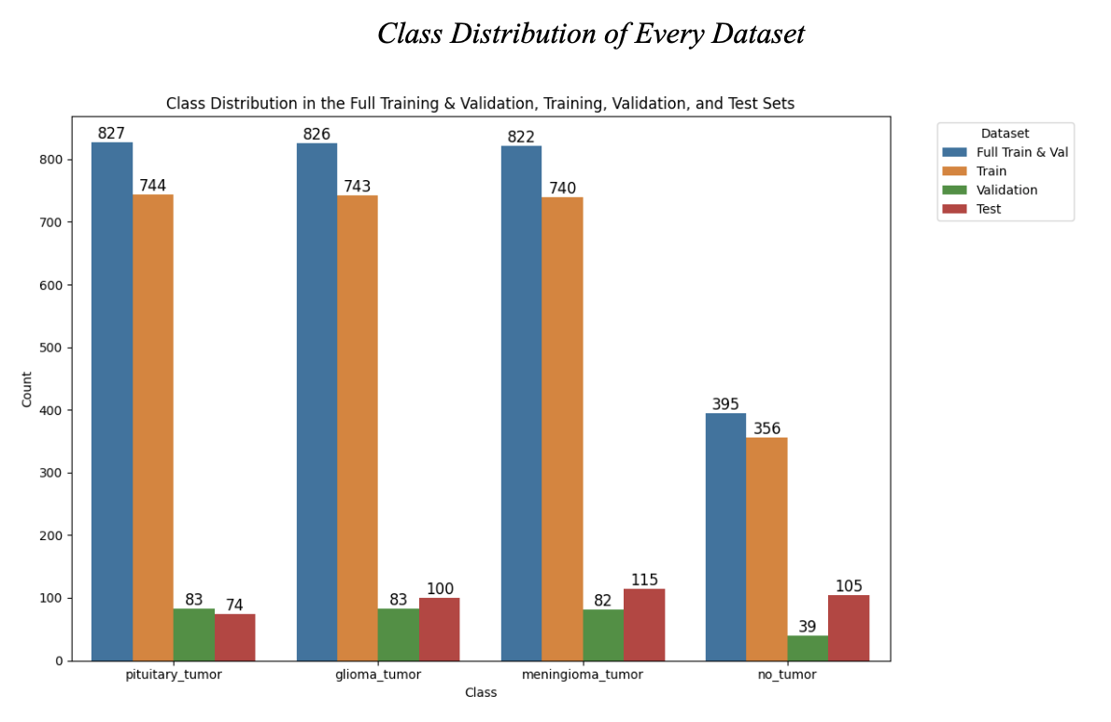

Slide 12
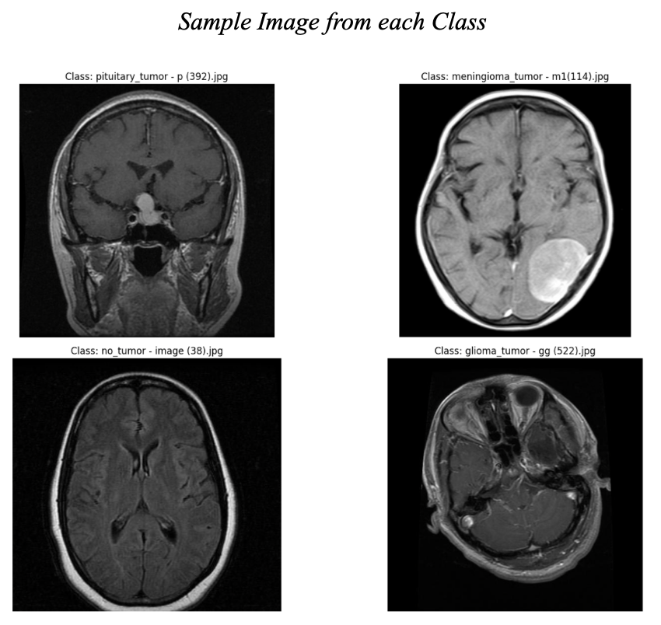

Slide 13
Data Augmentation
Increase the size of the data and counter the imbalance present in the class variable
Augmented the train set only
Not performed on the validation and test sets since doing so may lead to artificially high results for the model
Produce more diverse types of data, which may lead to the model in generalizing to a greater number of unseen images.

Slide 14
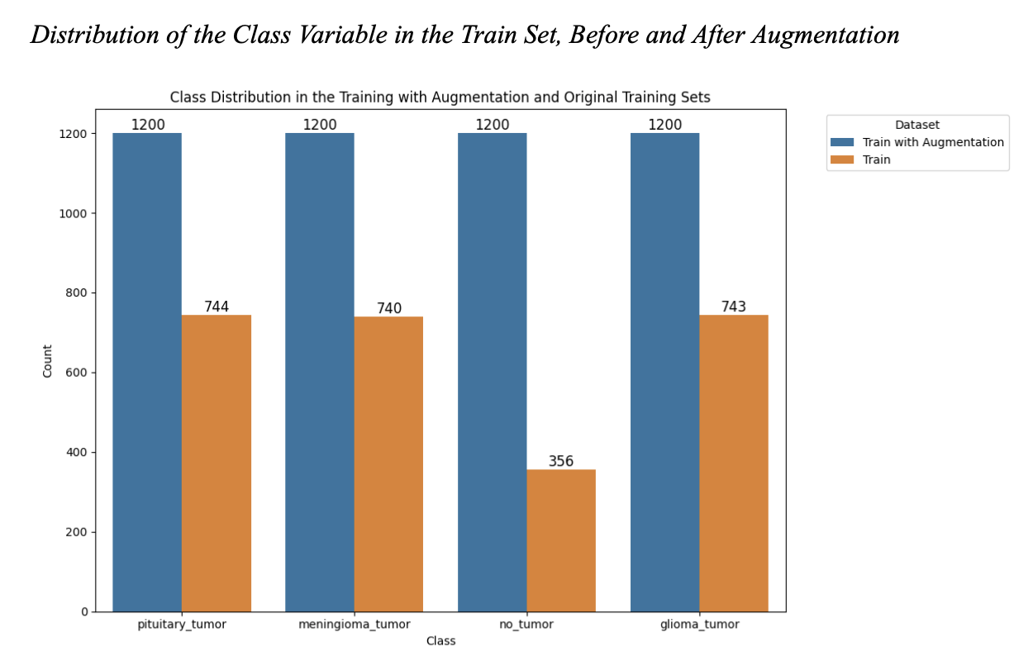

Slide 15
Data Augmentation, cont.
Specific augmentations: Random 90 degree rotations, contrast, and brightness changes
Rotations are chosen at random, and can constitute a 0 degree rotation (no rotation), or rotations by a factor of 90 degrees.
Model can be more robust to varying rotations and hopefully generalize better to new images.
Changes in contrast and brightness were chosen at random from a small range, specifically a factor of 0.2 for contrast and 0.1 for brightness
e.g. the images can at max be darkened or brightened by a factor of 10%
Contrast and brightness adjustments were kept to a small range in order to maintain the integrity of the medical images
Help the model generalize better to MRI images which may have some slight variability in their contrast and brightness levels

Slide 16
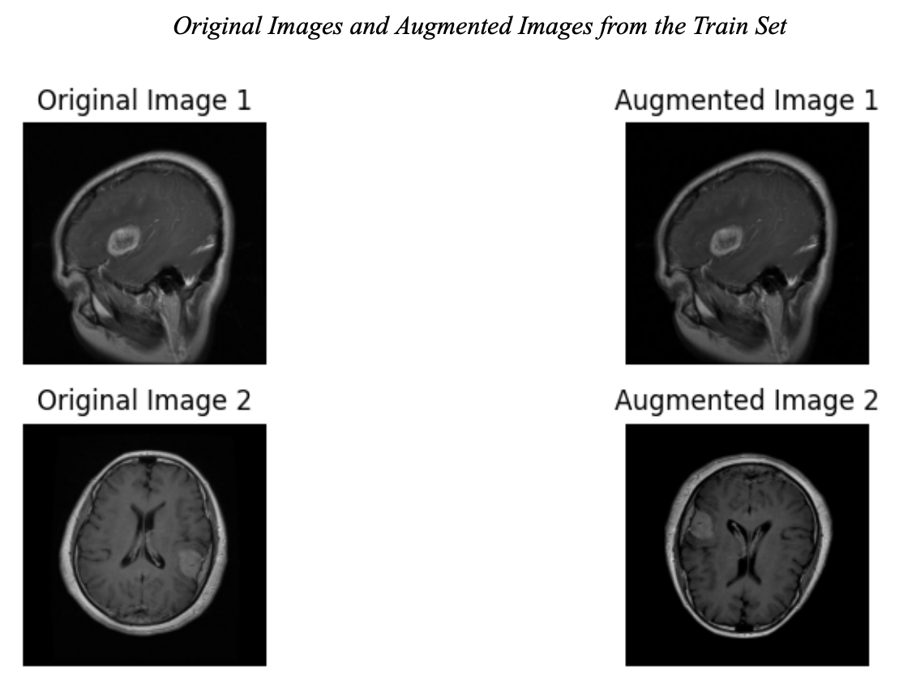

Slide 17
Transfer learning
Idea - to take a network that has been already trained on the quality large-size dataset (use of extracted features and established weights)
Widely proven approach image recognition, NLP and computer vision tasks
Pre-trained models: VGG-19, ResNet-50, InceptionV3, DenseNet121
Fine-tune to the project tasks by training on brain tumor image dataset
Benefits:
Efficiency - updated model doesn’t need large amounts of labeled data for fine-tuning
Depth of pre-training speeds up the fine-tuning process
Often leads to a better model performance

Slide 18
Pre-trained models description
VGG-19
143 million parameters
concept of deep convolutional network
ResNet-50
24 million parameters
concept of residual blocks and skip connections
InceptionV3
23.8 million parameters
concept of inception modules
DenseNet121
7 million parameters
concept of interconnection across all layers in a feed-forward fashion

Slide 19
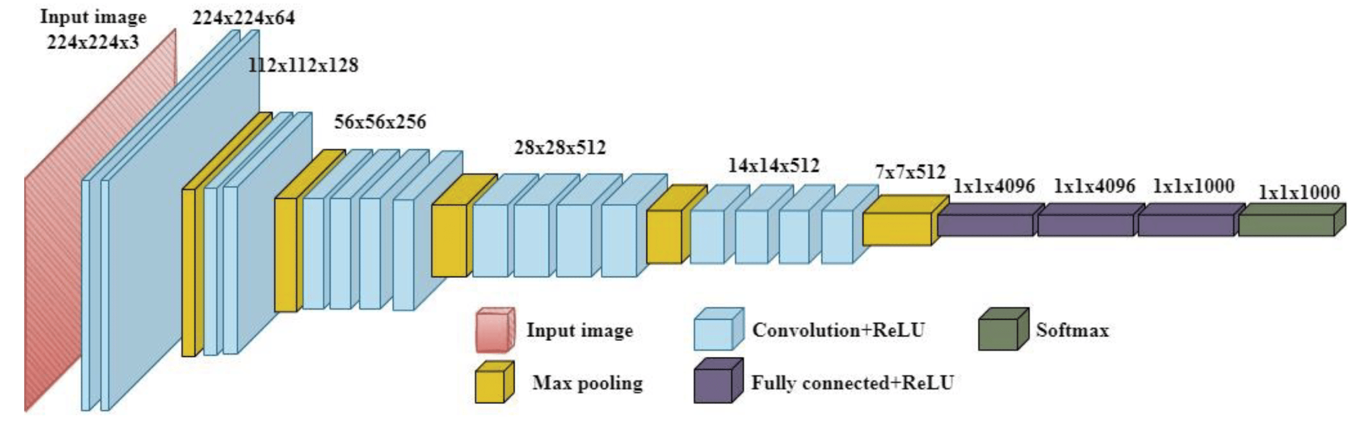
VGG-19 architecture
Note. Image credit: https://doi.org/10.3390/agriengineering4040056

Slide 20
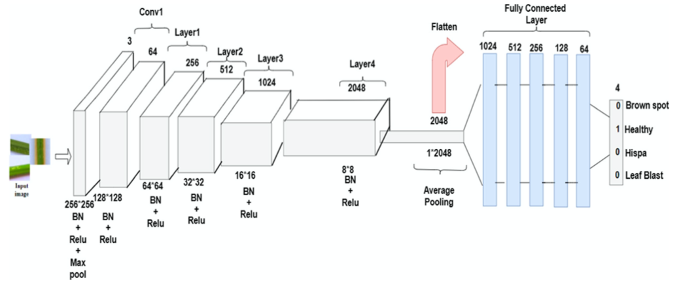
ResNet-50 architecture
Note. Image credit: https://doi.org/10.1007/s00521-022-07793-2

Slide 21
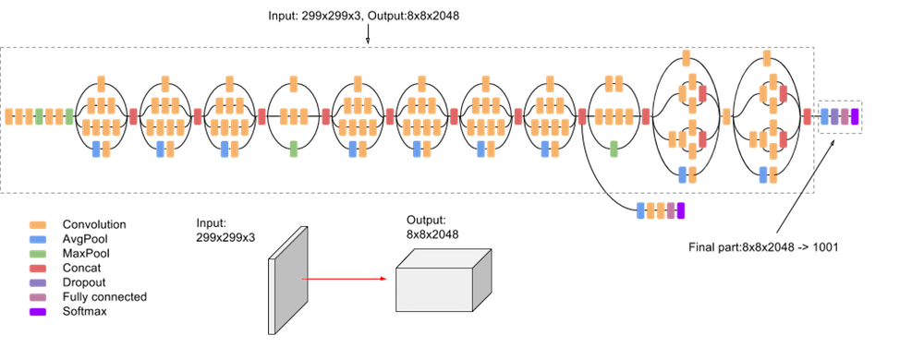
InceptionV3 architecture
Note. Image credit: https://doi.org/10.14569/IJACSA.2019.0100107

Slide 22
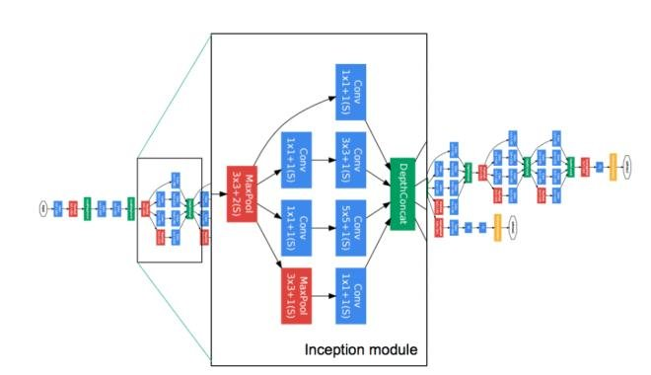
InceptionV3 - Inception module structure
Note. Image credit: https://doi.org/10.35940/ijeat.B3226.129219

Slide 23
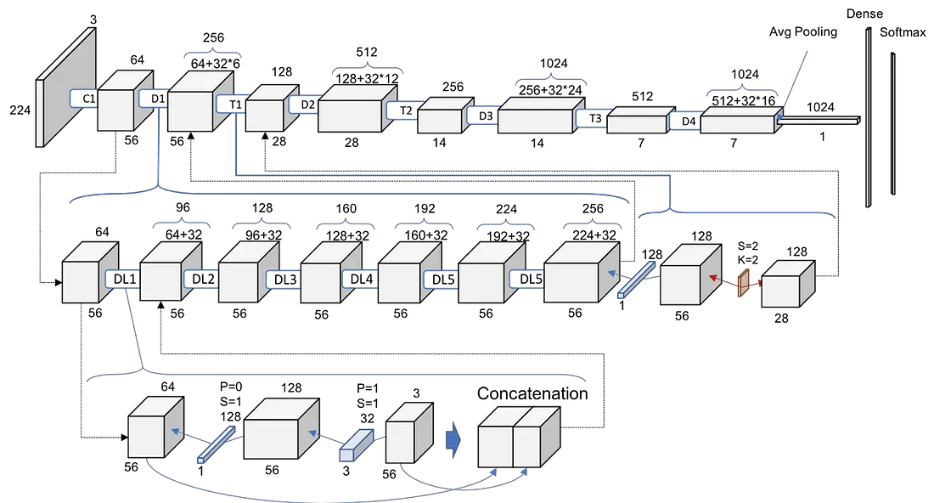
DenseNet121 architecture
Note. Image credit: https://towardsdatascience.com/understanding-and-visualizing-densenets-7f688092391a

Slide 24
Important architecture elements and parameters
ReLU activation function
positive output for positive input
zero value output for negative input
introduces non-linearity to the model
computationally efficient due to simplicity
Softmax activation function layer
accepts logits and outputs a probability distribution, which is directly used to do multi-classification over four classes.
Sparse categorical cross-entropy
directly accepts integer values assigned to each class, without the need to preprocess the data with one-hot encoding
memory efficient
Adam optimizer
provides separate learning rates for each parameter => more precise weights update

Slide 25
Model evaluation metrics
A comprehensive evaluation of the models' performance:
Accuracy - ratio of correct predictions to the total number of instances in the dataset.
Confusion matrix - distribution across multi-classes and estimate of the portion of confused predictions (errors made by model)
Precision - tells how much the model is trustworthy when predicting class as positive
Recall - measures the ability of the model to capture all positive instances in the dataset
F1-score is a is the harmonic mean of macro precision and macro recall.
Macro - specific method of calculating these metrics in multi-class classification problems. In multi-class settings, each class is treated independently, and then the results are averaged.
The closer precision/recall/F1-score metrics are to 1, the better the model's ability to assign the correct label for each instance.
Area under the receiver operating characteristic curve (AUC-ROC) - robust metric to evaluate model performance at various thresholds.
completely inaccurate model would have an AUC-ROC score of 0.5, while a robust model would have a score of 1.

Slide 26
Model ensemble
Since the project utilizes four different neural networks it is reasonable to try to aggregate predictions from each model and try to achieve better accuracy. This approach is called ensemble.
Benefits:
Aimed for Improved accuracy
Reduced overfitting due to averaging predictions
Typically, provides better accuracy considering differences in data and noise levels
Downturns:
Increased computational complexity and time spent on training.
Models must be selected mindfully to achieve a good combination for ensembling.

Slide 27
Compatibility with Pre-Trained Models
Prepare the train, validation & test sets to be compatible with the pre-trained models, namely: VGG-19, Inception V3, ResNet-50, and DenseNet121
The images in these datasets are of varying sizes.
The pre-trained models were trained on datasets with specific image dimensions
Thus, the images in each dataset need to be resized in order to be compatible with the pertinent pre-trained model.
Ex: 224x224 for VGG19, 299x299 for InceptionV3
Images in the dataset are not fairly large and can be resized to lower dimensions without a significant loss of detail - techniques like padding and antialiasing are not necessary

Slide 28
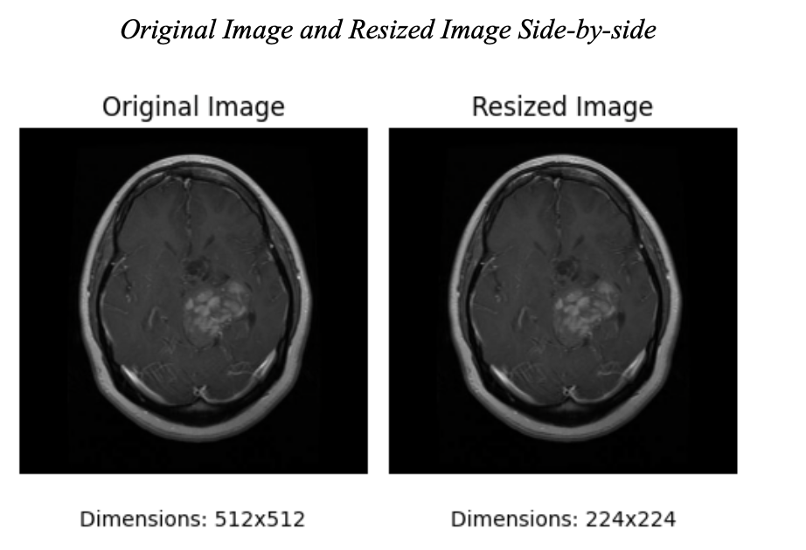

Slide 29
Compatibility with Pre-Trained Models, cont.
After resizing, the pixel values of the images need to be adjusted to match what the pre-trained model expects.
Each pre-trained model’s “preprocess_input” function within their specific module in TensorFlow.
Ex: for VGG-19, “tensorflow.keras.applications.vgg19.preprocess_input”
Steps to preprocess the datasets to be compatible with the pre-trained models were wrapped into a function.

Slide 30
Compatibility with TensorFlow
The train, validation, and test datasets were converted to be compatible with training in TensorFlow using the ‘Dataset’ API.
“from_tensor_slices” function was used to create a dataset from the image path and label tuples (the labels were encoded with a custom mapping)
Previous preprocessing function was used to process the images and get them in a state where they are compatible for the pertinent pre-trained model
Training set was shuffled to ensure that bias or irrelevant patterns are not introduced/acquired in the model training phase due to the order of the images
Training, validation, and test sets were batched, cached, and prefetched with TensorFlow’s ‘AUTOTUNE’
Increase the efficiency of the computations, and to decrease the time at which the model converges.

Slide 31
Data Modeling

Slide 32
Initial Training
Each of the base pre-trained models were loaded in using their respective modules in TensorFlow.
Base VGG-19 model instantiated by calling “tensorflow.keras.applications.vgg19.VGG19”
For each of the pre-trained models, the ‘weights’ parameter was left as ‘imagenet’, and the ‘include_top’ parameter was set to False to remove the last few fully-connected layers at the top of each network.
‘input_shape’ parameter was set to the value that was used during data preprocessing, namely the input size that the pre-trained model expects
Ex: (224, 224, 3) for VGG-19

Slide 33
Initial Training, cont.
After the base pre-trained model was instantiated, all of the model’s layers were frozen by setting the “trainable” variable to False
Afterwards, a GlobalAveragePooling2D layer was added
To reduce the dimensions of the feature maps and retain the most important information
Experimented with different combinations of Dense layers with a varying number of neurons and activation functions, and Dropout layers to reduce overfitting.
The last layer is a Dense layer with 4 neurons corresponding to the number of classes, and a ‘softmax’ activation function due to the task being multiclass classification
The optimizer used is “adam”, and the loss function is “sparse_categorical_crossentropy”, since the class labels were integer encoded instead of one-hot encoded

Slide 34
Initial Training, cont.
A callback with an early stopping mechanism was utilized to monitor if the model was overfitting.
The validation loss was monitored with a patience level of 3
Thus, if the validation loss did not improve after 3 epochs, the training process was terminated.
The loss and accuracy on the test set was then obtained to determine how well the model was performing to completely unseen data.
The accuracy of each model on the test set was not very notable
For each model, a dropout rate of 0.2 after the GlobalAveragePooling2D layer without additional dense layers seemed to produce the best results on the test set
The accuracy levels were all below 75%

Slide 35
Fine-tuning
Fine-tuning of the models was then employed in an attempt to achieve a better performance of the models.
Fine-tuning involves unfreezing some of the top layers of the base pre-trained model, recompiling the model so that the changes can take effect, and to continue training the model after the initial training (when all of the layers were frozen)
Allows the model to adapt better to the specific features of a dataset
The initial epoch during the fine-tuning phase was set to the last epoch during the initial training.
Same optimizer (with a lower learning rate since the model is much larger and can overfit easier), loss function, and early stopping mechanism was used

Slide 36
Fine-tuning, cont. and Model Ensembles
The number of frozen layers for each model was experimented with.
Choosing the number of frozen layers requires some consideration, since having a larger number of trainable layers is computationally more expensive
May also lead to overfitting (since the model may become very adapted to the training data and may not generalize well to new images)
After the four fine-tuned models were finalized after some experimentation with the number of frozen layers, model ensembles were created
One ensemble involved using soft-voting (where the final class prediction is made by averaging the class probabilities from each model)
The other involved majority voting (where each model returns a class label and the class with the most votes is returned as the final prediction)

Slide 37
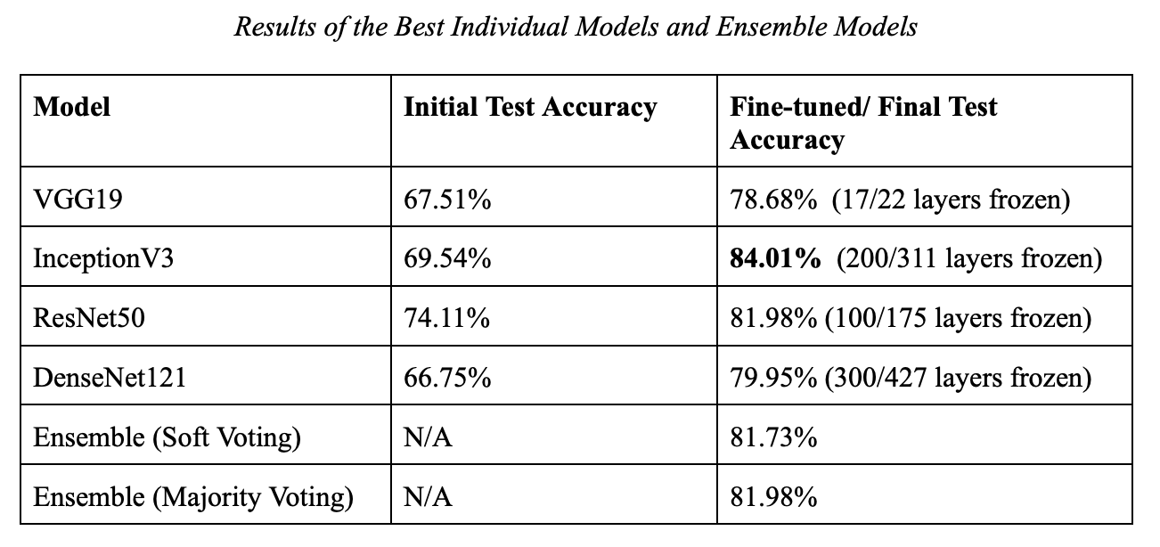

Slide 38
Results
The individual models had significantly improved accuracy on the test set after fine-tuning.
The fine-tuned InceptionV3 model had the highest test set accuracy out of all of the models, including the ensemble models
The ensemble models most likely performed worse since the errors of the individual models are correlated; the individual models are likely not diverse enough
Thus, the final model that is chosen is the fine-tuned InceptionV3 model.
Various metrics and visualizations of the results of the model are shown next.

Slide 39
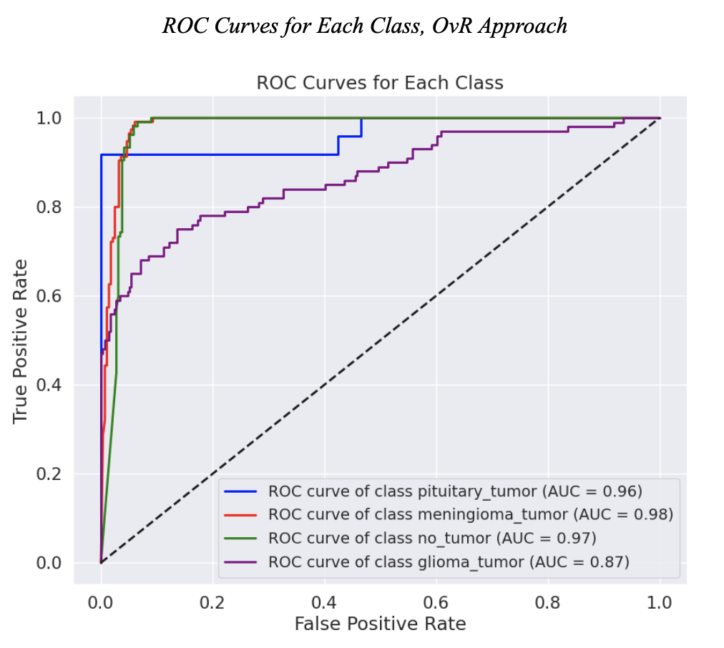

Slide 40
ROC Curves
The ROC curves and corresponding AUC scores show that the model distinguishes exceptionally well between positive cases and non-positive cases for the pituitary tumor, meningioma tumor, and no tumor classes.
The glioma tumor class is noticeably worse than the other 3 classes, with a lower true positive rate for the same levels of false positive rate compared to the other classes.
The macro average ROC-AUC score is 0.95, which indicates good distinguishing ability of the model when considering all classes.

Slide 41
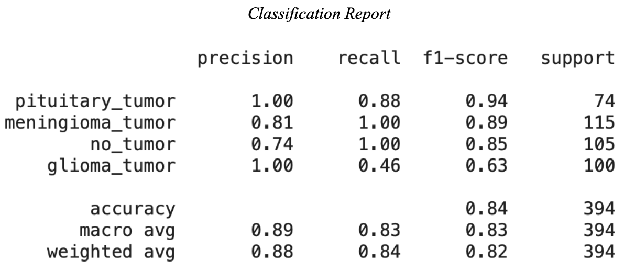

Slide 42
Classification Report
F1-scores for the pituitary tumor & meningioma tumor classes are the highest.
Recall for the pituitary tumor class is 0.88, indicating some false negatives and thus some pituitary tumor cases were predicted to be other classes by the model.
The precision of 1 indicates that every time the model made a positive prediction for the pituitary class, it was correct.
A precision of 0.81 for the meningioma class indicates false positives for this class.
A recall of 1 indicates that every case of meningioma tumor was identified (i.e. no false negatives)
The high F1-scores reflect the perfect precision and perfect recall of the pituitary tumor and meningioma tumor classes, respectively.

Slide 43
Classification Report, cont.
The no tumor class has perfect recall, but a precision of 0.74 indicating some cases with tumors were incorrectly predicted to have no tumors.
The glioma tumor class has perfect precision, but a poor recall which is reflected in the F1-score of 0.63.
The low recall for the glioma class indicates that many cases of glioma tumor were incorrectly predicted to be other classes.
A macro average F1-score of 0.83 indicates good performance when all of the classes are considered together.

Slide 44
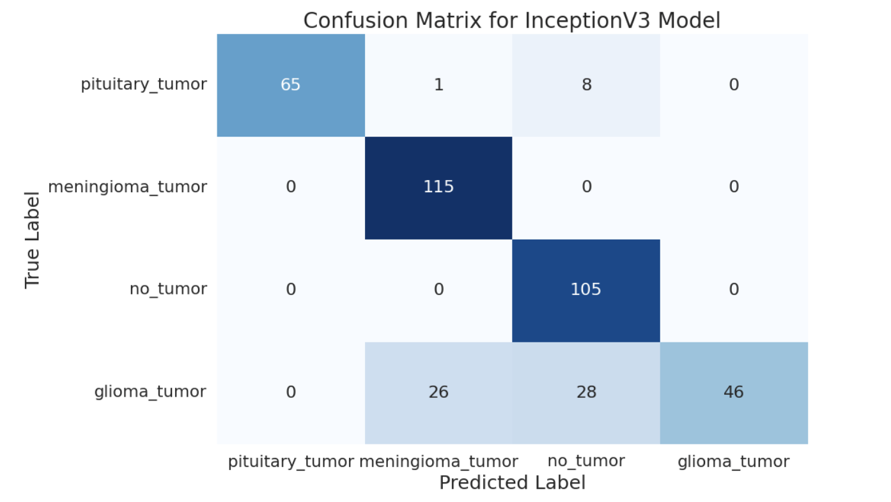

Slide 45
Confusion Matrix
The confusion matrix goes into further detail into the results of the classification report.
65 cases of pituitary tumors were correctly identified and 9 cases of pituitary tumor were predicted to be other classes, which explains the recall of 0.88.
All 115 cases of meningioma tumor were identified as such.
27 cases of non-meningioma tumors were predicted to be a meningioma tumor case, which explains the recall of 1 and the precision of 0.81 for the meningioma tumor class
Similarly, for the no tumor cases, every instance was identified
36 cases of tumors (28 for glioma tumor and 8 for pituitary tumor) were incorrectly predicted to be of the no tumor class, which is reflected in the precision of the no tumor class
The low recall of the glioma tumor class is reflected in the fact that 26 glioma tumor cases were incorrectly predicted to be meningioma tumor cases, and 28 glioma tumor cases were incorrectly predicted to be no tumor cases.

Slide 46
Conclusion
The model demonstrates strong performance for most tumor types and the no tumor class.
The model most notably struggles in the recall of glioma tumors, often misclassifying them as having no tumor or a meningioma tumor, which indicates an area that could be targeted for improvement.
Overall, when considering all of the metrics such as the macro average AUC score and macro average F1-score, the model is capable of distinguishing between classes with a high level of confidence.

Slide 47
References
AlTahhan, F. E., Khouqeer, G. A., Saadi, S., Elgarayhi, A., & Sallah, M. (2023). Refined automatic brain tumor classification using hybrid convolutional neural networks for MRI scans. Diagnostics, 13(5), 864. https://doi.org/10.3390/diagnostics13050864
Anand, V., Gupta, S., Gupta, D., Gulzar, Y., Xin, Q., Juneja, S., Shah, A., & Shaikh, A. (2023). Weighted average ensemble deep learning model for stratification of brain tumor in MRI images. Diagnostics, 13(7), 1320. https://doi.org/10.3390/diagnostics13071320
Asiri, A. A., Shaf, A., Ali, T., Pasha, M. A., Aamir, M., Irfan, M., Alqahtani, S., Alghamdi, A. J., Alghamdi, A. H., Alshamrani, A. F., Alelyani, M., & Alamri, S. (2023). Advancing brain tumor classification through fine-tuned vision transformers: A comparative study of pre-trained models. Sensors, 23(18), 7913. https://doi.org/10.3390/s23187913
Asiri, A. A., Shaf, A., Ali, T., Shakeel, U., Irfan, M., Mehdar, K. M., Halawani, H. T., Alghamdi, A. H., Alshamrani, A. F., & Alqhtani, S. M. (2023). Exploring the power of Deep Learning: Fine-tuned vision transformer for accurate and efficient brain tumor detection in MRI scans. Diagnostics, 13(12), 2094. https://doi.org/10.3390/diagnostics13122094
Brain tumor detection using deep convolutional neural network. (2023). The International Conference on Scientific Innovations in Science, Technology, and Management. https://doi.org/10.59544/poda4062/ngcesi23p130
Cahall, D. E., Rasool, G., Bouaynaya, N. C., & Fathallah-Shaykh, H. M. (2019). Inception modules enhance brain tumor segmentation. Frontiers in Computational Neuroscience, 13. https://doi.org/10.3389/fncom.2019.00044
Cinar, N., Ozcan, A., & Kaya, M. (2022). A hybrid densenet121-UNET model for Brain tumor segmentation from Mri Images. Biomedical Signal Processing and Control, 76, 103647. https://doi.org/10.1016/j.bspc.2022.103647
Nguyen T-H, Nguyen T-N, Ngo B-V. A VGG-19 Model with Transfer Learning and Image Segmentation for Classification of Tomato Leaf Disease. AgriEngineering. 2022; 4(4):871-887. https://doi.org/10.3390/agriengineering4040056
Siddaiah, N., Vignesh, C., Narendra, T., Pujitha, K., &amp; Madhu, D. (2022). Brain tumor detection from MRI scans using VGG- 19 networks. 2022 10th International Conference on Emerging Trends in Engineering and Technology - Signal and Information Processing (ICETET-SIP-22). https://doi.org/10.1109/icetet-sip-2254415.2022.9791683
Rathore, S., Rana, T., Mittal, U., Gupta, T., Malik, N., & A S, M. S. (2023). Brain tumor detection by using resnet-50 and image processing tools. 2023 3rd International Conference on Advance Computing and Innovative Technologies in Engineering (ICACITE). https://doi.org/10.1109/icacite57410.2023.10183081
Saeedi, S., Rezayi, S., Keshavarz, H., &amp; R. Niakan Kalhori, S. (2023). MRI-based brain tumor detection using convolutional deep learning methods and chosen machine learning techniques. BMC Medical Informatics and Decision Making, 23(1). https://doi.org/10.1186/s12911-023-02114-6
Stephen, A., Punitha, A. & Chandrasekar, A. Designing self-attention-based ResNet architecture for rice leaf disease classification. Neural Comput & Applic 35, 6737–6751 (2023). https://doi.org/10.1007/s00521-022-07793-2
Vankdothu, R., Hameed, M. A., & Fatima, H. (2022). A brain tumor identification and classification using Deep Learning based on CNN-LSTM method. Computers and Electrical Engineering, 101, 107960. https://doi.org/10.1016/j.compeleceng.2022.107960

